Slide 1

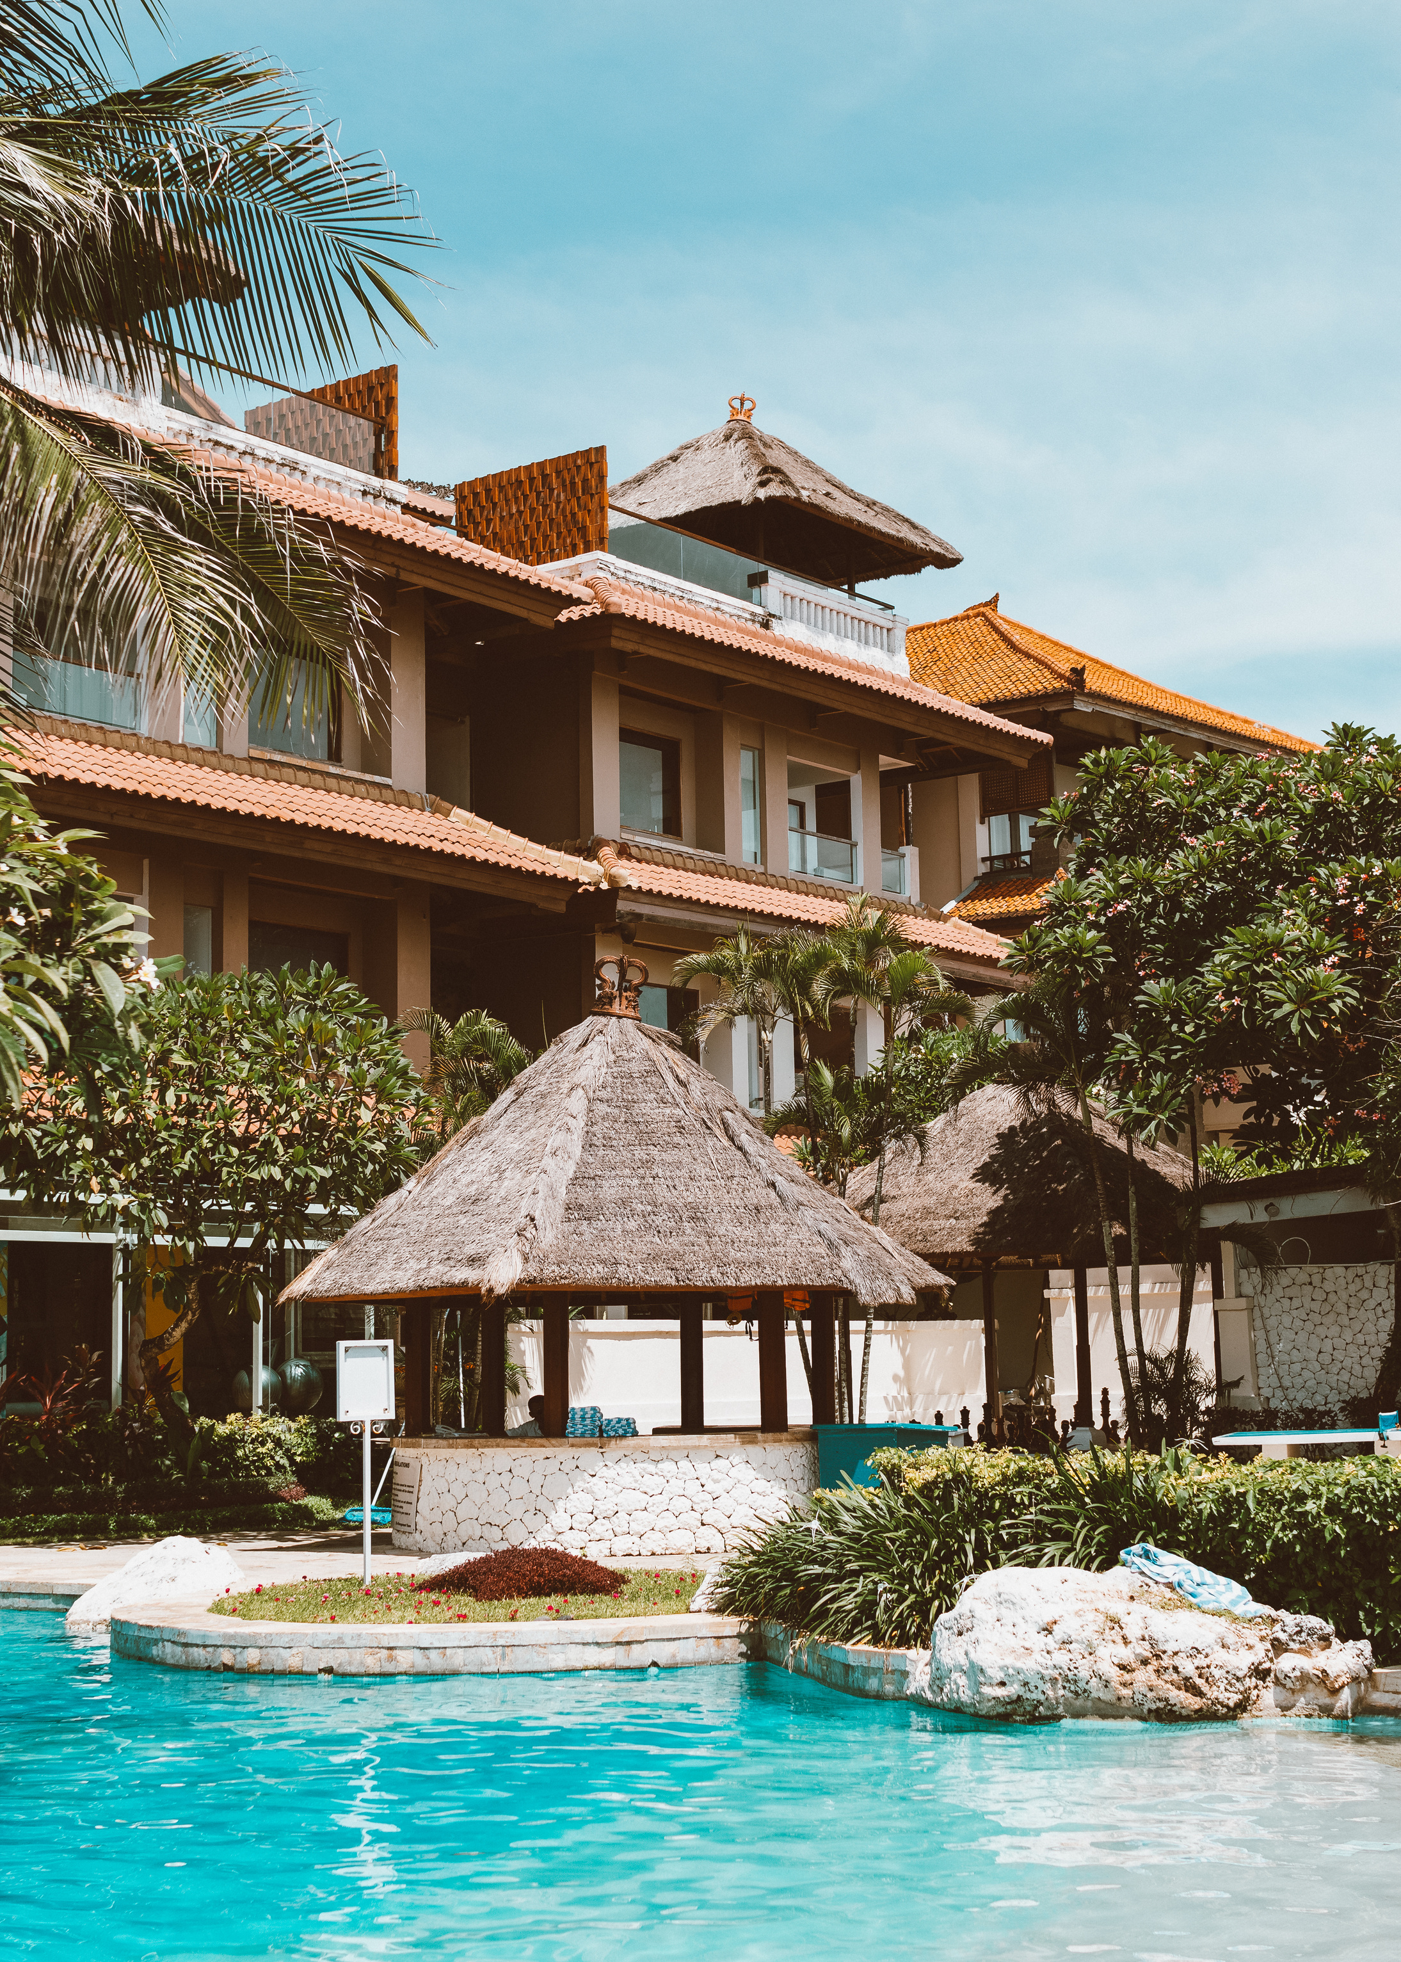
ATLIQ Hospitality
Enabling ATLIQ Hospitality with Data-Driven Decisions for a Smarter Future.

Slide 2
Agenda
Problem Statement
Business Model
Insights
Task
Action
Result
Presentation Title

Slide 3
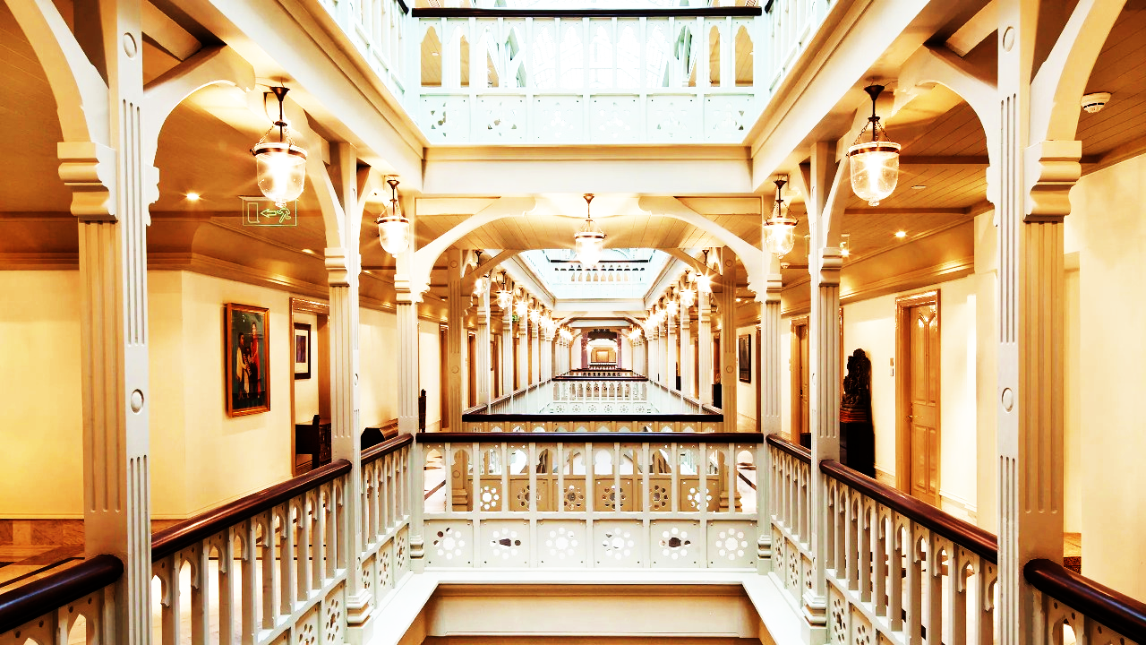
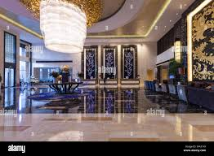
Problem Statement
AtliQ Grands owns multiple five-star hotels across India, offering two distinct categories: Business Hotels and Luxury Hotels. These hotels are strategically located in major cities such as Delhi, Mumbai, Hyderabad, and Bangalore, catering to both corporate travelers and high-end leisure guests. However, due to strategic moves by competitors and ineffective decision-making in management, AtliQ Grands is experiencing a decline in market share and revenue across both categories.
To counter this, the managing director aims to integrate Business and Data Intelligence to enhance decision-making, optimize pricing strategies, and improve customer experience.

Slide 4

ATLIQ HOTEL TYPE
ATLIQ
BUSINESS
ATLIQ CITY
ATLIQ BAY
ATLIQ PALACE
ATLIQ SEASONS
LUXURY
ATLIQ GRANDS
ATLIQ EXOTICA
ATLIQ BLU
BOOKING PLATFORM
ROOM TYPE
MAKE YOUR TRIP
LOG TRIP
TRIPSTER
ATLIQGRANDS.COM
OFFLINE BOOKING
STANDARD
ELITE
PREMIUM
PRESIDENTIAL

Slide 5


Tools & Technologies
Jupyter _Notebook, Python, Pandas, Matplotlib
For our analysis, we have been provided with three months of booking data from all ATLIQ Grand hotels. The dataset consists of five Excel files, each containing essential information:
Dim _Date – Contains date-related details for analysis.
Dim _Hotels – Provides information about different ATLIQ hotels across various cities.
Dim _Rooms – Includes details about room types and categories.
Fact _Aggregated_Bookings – Summarized booking data, useful for high-level insights.
Fact _Bookings – Detailed transaction-level booking records.
task

Slide 6
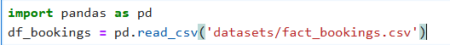
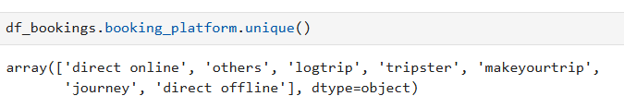
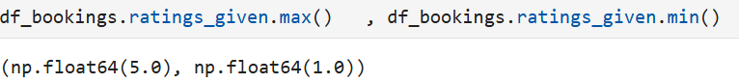
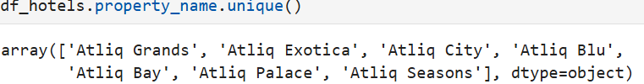
ACTIONS
DATA IMPORT
EXPLORATORY DATA ANALYSIS
DATA CLEANING
DATA TRANSFORMATION
INSIGHTS
RECOMMENDATIONS
DATA IMPORT
EXPLORATORY DATA ANALYSIS

Slide 7
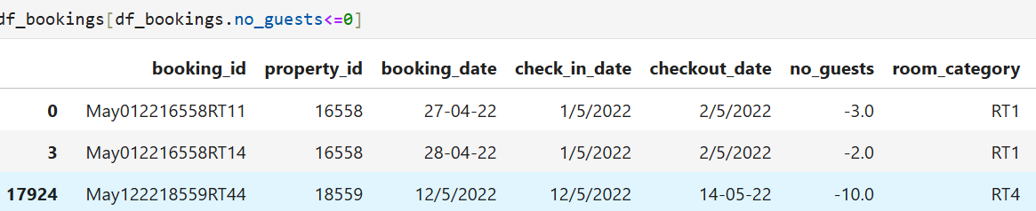
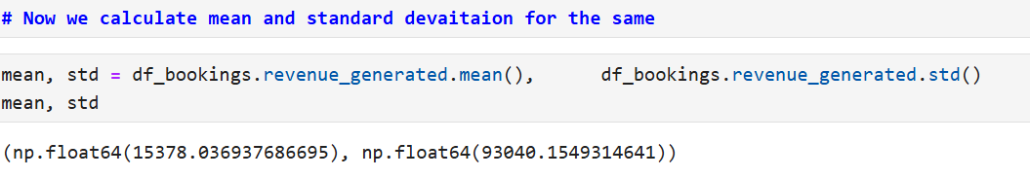
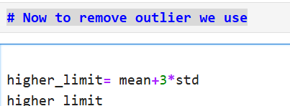
DATA CLEANING

Slide 8
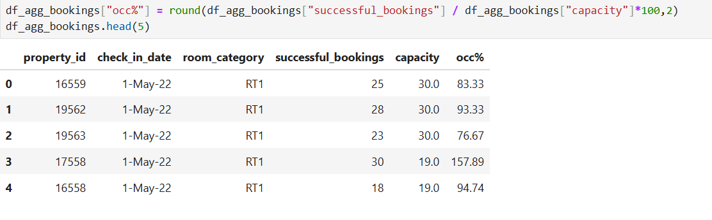
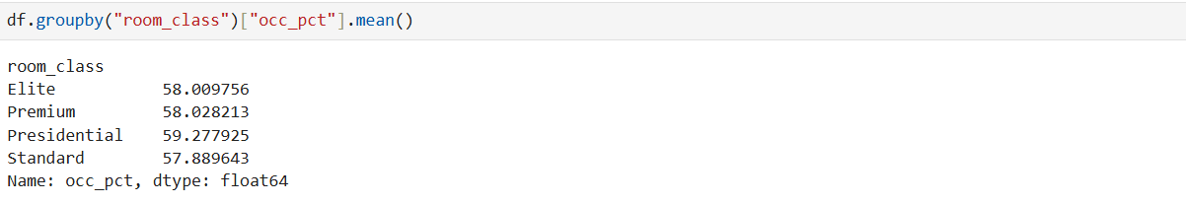
DATA TRANSFORMATION
INSIGHTS

Slide 9
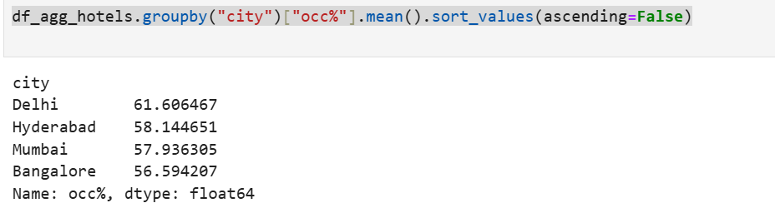
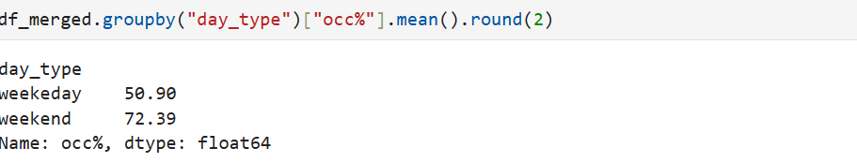

Slide 10
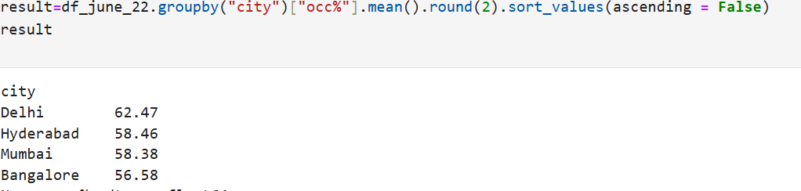
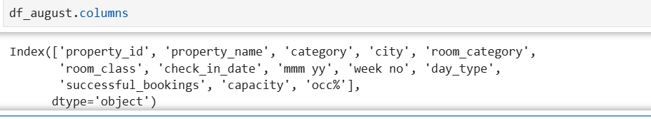

Slide 11
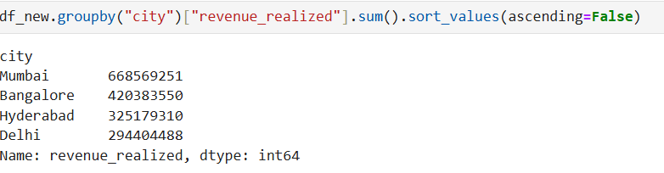
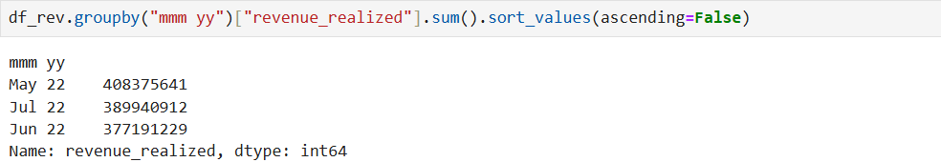

Slide 12

Recommendations
Offering exclusive discounts and vacation packages can attract more guests, especially during off-peak seasons, making stays more affordable while boosting occupancy rates.
Partnering with third-party services like spas, complimentary dining, or live entertainment adds more value to a guest’s experience, encouraging longer stays and repeat visits.
Implementing a personalized reward system for frequent guests, such as free upgrades or special perks, can enhance customer loyalty and keep them coming back.

Slide 13




Thank you
Mahima Pathania
mahimapathania1405 @gmail.com

